Slide 1
Word Embedding
You shall know a word by the company it keeps. (Firth, 1957)

Slide 2
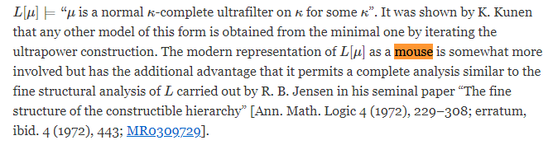
MR2768698 Steel, John R.(1-CA) An outline of inner model theory. Handbook of set theory. Vols. 1, 2, 3, 1595–1684, Springer, Dordrecht, 2010. 03E45 (03E15 03E35 03E55 03E60)
It is a well-documented phenomenon that the set-theoretic universe becomes more complex as one assumes stronger and stronger large cardinal axioms. For instance, the existence of a measurable cardinal implies that the universe is far away from the constructible universe L, and this can be measured via objective means. If there is a measurable cardinal then the constructible universe computes no successor cardinal correctly and, in particular, the set of reals of the constructible universe is countable.
Notes:
https://blogs.ams.org/beyondreviews/2016/08/27/an-exceptional-review-about-inner-model-theory/

Slide 3
Unifying Word Embeddings and Matrix Factorization — Part 1
With Word2vec, or, as it is almost always used in implementation, Skip-gram with Negative Sampling (SGNS)⁴, the objective of context prediction is directly and locally imposed within (what is presented as) a shallow neural network. Meanwhile, matrix factorization methods such as SVD⁵ and the weighted least-squares optimization of GloVe⁶ work directly on global pre-computed corpus statistics. These latter methods implicitly construct word embeddings that predict context; or, we could equivalently state (as will be discussed later) that SGNS implicitly constructs word embeddings that predict the global corpus statistics.
Notes:
https://medium.com/radix-ai-blog/unifying-word-embeddings-and-matrix-factorization-part-1-cb3984e95141

Slide 4
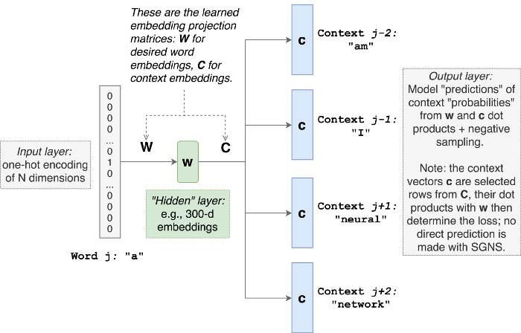
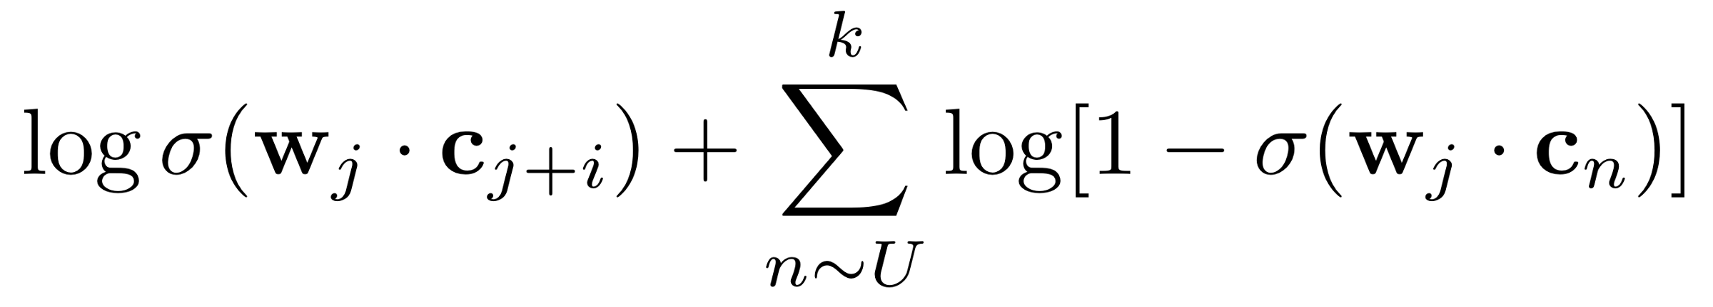
Skip-Gram with Negative Sampling (N~10)
c_{n} out of context words
Negative sample
UF =
max
Notes:
https://medium.com/radix-ai-blog/unifying-word-embeddings-and-matrix-factorization-part-1-cb3984e95141

Slide 5
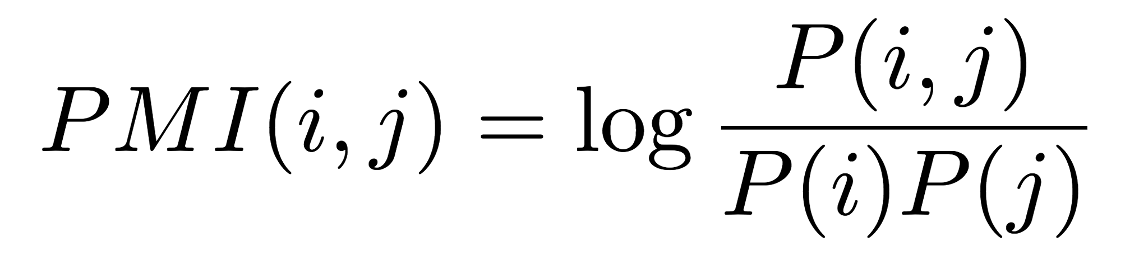
Matrix Factorization
Levy and Goldberg in 2014 paper⁷ “Neural word embedding as implicit matrix factorization” prove that, despite seeming like a local neural network on the surface, SGNS vectors are implicitly trained to factorize a matrix containing global corpus statistics, similarly to GloVe and singular value decomposition.
The matrix of global corpus statistics is defined, using the notation described above, as the shifted point-wise mutual information matrix, M, where k~N.
Notes:
https://medium.com/radix-ai-blog/unifying-word-embeddings-and-matrix-factorization-part-1-cb3984e95141

Slide 6
So What?
So Word2vec is implicitly doing matrix factorization of a huge matrix filled PMI statistics computed from the corpus. Intuitively, SGNS wants to make word and context embeddings such that their dot product represents how likely it is that they occur together — that is, define the word embedding by the context it keeps across the entire corpus.
It now seems like we can implement SGNS with a matrix factorization algorithm, so long as we do the following:
Precompute the correct shifted-PMI matrix from the corpus; and,
Determine the correct corresponding loss function for the factorization.
Notes:
https://medium.com/radix-ai-blog/unifying-word-embeddings-and-matrix-factorization-part-1-cb3984e95141

Slide 7
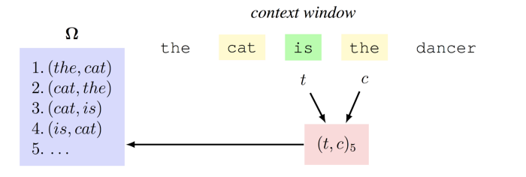
Part2: Matrix Factorization
An example of how this scanning over the corpus occurs with a context window size of w=1. As we read over the corpus, we store every pair that we observe into a (very, very, very, long) list called Ω (mega). The items in Ω are the positive samples, and it will be filled with approximately |Ω| = 2 * w * len(corpus) samples; recall that the corpus length is often on the order of billions of words!
The definition of the context window is symmetric, and that SGNS treats words separately as terms and contexts. In this example, “is” is the current term t, and “the” is the current context c, which will be filled into the 5th slot of Ω. Recall that SGNS will learn two sets of embeddings, one for the terms and one for the contexts, and (normally) SGNS will only output the term vectors, which are what we call the “word embeddings”.
Notes:
https://medium.com/radix-ai-blog/unifying-word-embeddings-and-matrix-factorization-part-2-a0174ace78b8
https://medium.com/radix-ai-blog/unifying-word-embeddings-and-matrix-factorization-part-1-cb3984e95141

Slide 8
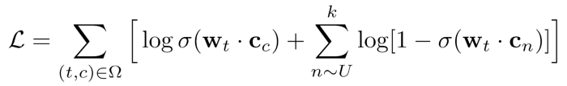
Positive Samples + Negative Samples
word embedding w_{t} will receive gradient updates positively from c_{c} and negatively for all k negative samples c_{n}
The inner summation represents the negative sampling of SGNS, where, for every positive sample in Ω, k negative samples are drawn from the context unigram distribution U of the corpus. This distribution is easy to define by counting the unigram statistics from the corpus, although Mikolov et al. [1] found that it was necessary to use exponential smoothing on this distribution in order to obtain good results (see Levy & Goldberg (2015) for details [2]).
Notes:
https://medium.com/radix-ai-blog/unifying-word-embeddings-and-matrix-factorization-part-1-cb3984e95141

Slide 9
Counting up the Corpus Statistics
To turn SGNS into matrix factorization, we must ask, for every term-context pair (i,j):
How many times was (i,j) positively sampled? And,
How many times was (i,j) negatively sampled?
Let N be the total length of Omega; then, the probability of (i,j)-cooccurrence is just: P(i,j) = N_ij / N.
Notes:
https://medium.com/radix-ai-blog/unifying-word-embeddings-and-matrix-factorization-part-1-cb3984e95141

Slide 10
backup

Slide 15
Tomas Mikolov et al. released the word2vec tool
Skip-gram model
Simple NN with one HL
The weights of the HL are word vectors
Stanford’s GloVe: Global Vectors for Word Representation
Selivanov’s text2vec

Slide 16
GloVe

Slide 17
Links
https://towardsdatascience.com/word-embeddings-exploration-explanation-and-exploitation-with-code-in-python-5dac99d5d795
https://www.geeksforgeeks.org/python-word-embedding-using-word2vec/
http://dsnotes.com/post/text2vec/
http://text2vec.org/glove.html
http://mccormickml.com/2016/04/19/word2vec-tutorial-the-skip-gram-model/

Slide 18
https://www.datascience.com/resources/notebooks/word-embeddings-in-python
https://www.datascience.com/blog/page/3
https://www.datascience.com/blog/top-reasons-data-scientists-change-jobs
https://www.datascience.com/blog/author/ruslana-dalinina

Slide 19
Kaggle links
https://www.kaggle.com/c/wikichallenge
https://www.kaggle.com/snap/amazon-fine-food-reviews
https://www.kaggle.com/snap/amazon-fine-food-reviews/kernels
https://www.kaggle.com/shashanksai/text-preprocessing-using-python
https://www.kaggle.com/currie32/summarizing-text-with-amazon-reviews

Slide 20
Slide packages from my work
3/6/2019 EMBEDDING.pptx
5/1/2017 Topics Labeling.pptx
5/4/2017 topics_pred_study.pptx
8/10/2017 Presentation5.pptx
# gloveDemo_v5.R
# July 19, 2017 - find new patterns for DISCONNECT LINE and ADDRESS CHANGE
7/17/2017 current_work_2017_07.pptx
6/8/2017 Meeting_2017_06_07.pptx
10/31/2017 glove_20171025.pptx
11/1/2017 help.pptx
11/15/2017 Short Message Analysis_2017_11_15.pptx LSI
5/4/2017 topics_pred_study.pptx
3/8/2019 __Ticket Analysis_Jan_2018.pptx
12/1/2017 TicketAnalysis_2017_11_28.pptx
TicketAnalysis_2017_12_06.pptx
TicketAnalysis_2018_01_10.pptx
Ticket_Analysis_2018_03_07.pptx

